Slide 1
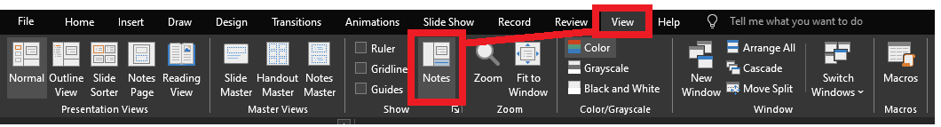
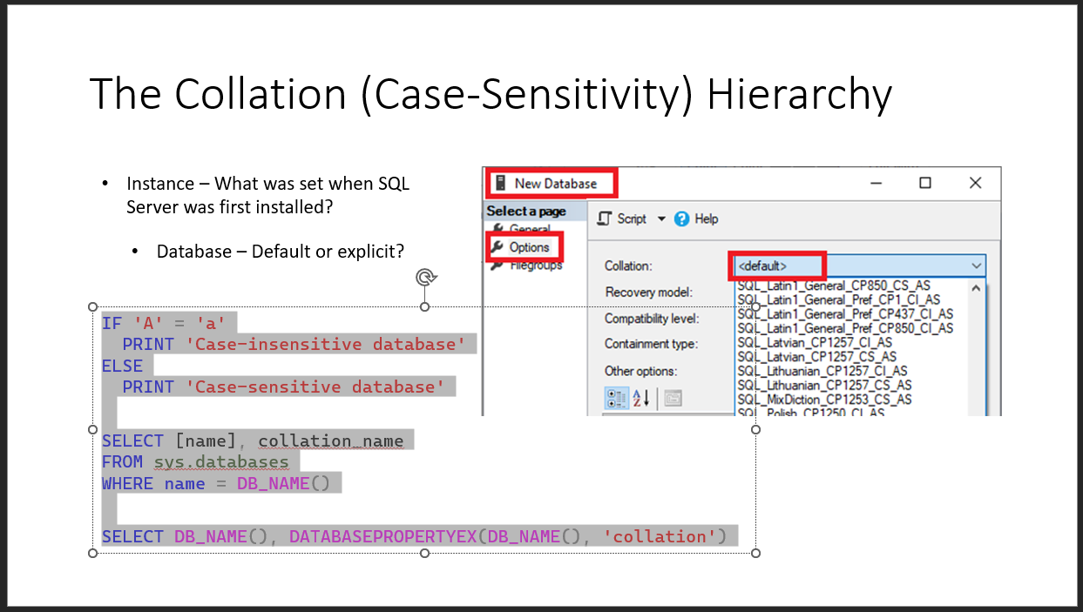
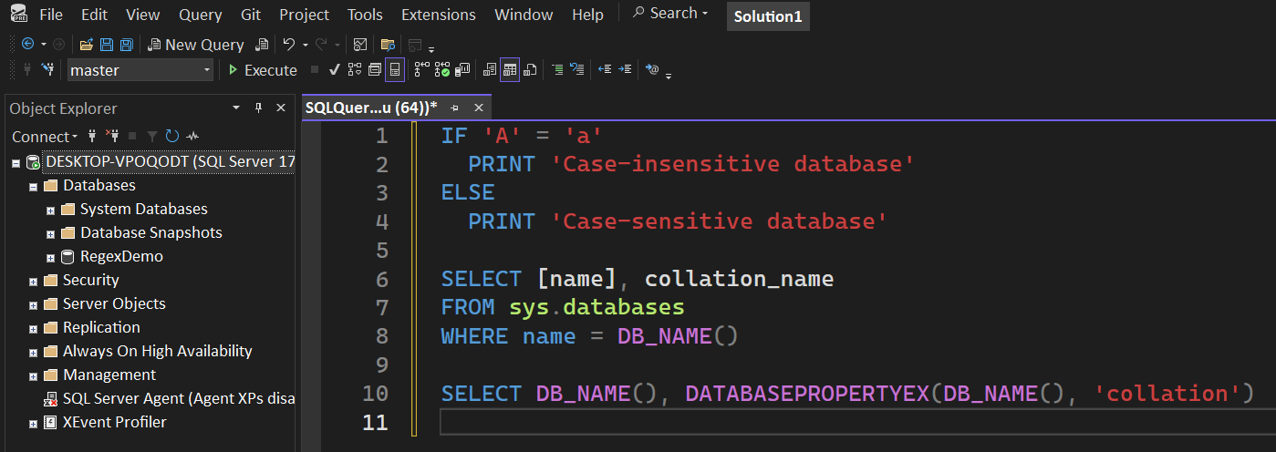
Reviewing after the presentation?
Be sure to enable the Notes for slide-specific content
Slides have working T-SQL that can be copied/pasted into SSMS

Slide 2


Advanced T-SQL Pattern Matching: Leveraging LIKE and Regular Expressions

Slide 3

LIKE REGEXP
Notes:
Microsoft introduced Regular Expressions for Azure SQL and Fabric. You’re probably here for the brand new Regular Expressions.
But are you using LIKE effectively? Do you know all the abilities it has?
Before we go into the new shiny toy, let’s level-set on LIKE, get up-to-speed, then we can compare and contrast the REGEXP operators.

Slide 4





Jeff Foushee
SQL Server Database Admin
Programmer
SQL Saturday speaker
Blackjack dealer
https://www.linkedin.com/in/jeff-foushee/
https://github.com/jbfoushee/MyPresentations/

Slide 5
stringable1 LIKE stringable2
SELECT [name], [description]
FROM [SomeTable]
WHERE [description] LIKE ...
“Stringable” refers to anything that can be represented as a string, including numerics, datetimes, guids, etc.

Slide 6

%

Slide 7
% – Wildcard of any length (even zero)
WHERE Column1 LIKE '%' -- returns all non-NULL values
WHERE Column1 LIKE 'A%' -- returns values starting with A
WHERE Column1 LIKE '%A' -- returns values ending with A
WHERE Column1 LIKE 'A%B' -- returns values starting with A
and ending with B
WHERE Column1 LIKE '%B%' -- returns values containing B

Slide 8

%

Slide 9

_
[]
[-]
[^]
%
ESCAPE
Notes:
There are more symbols available to LIKE beyond the % character.
If you don’t know about them, you can’t appreciate them.

Slide 10
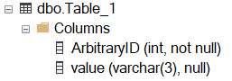
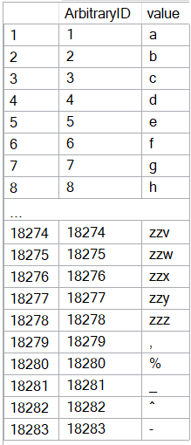
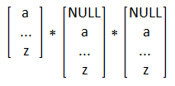
CREATE TABLE dbo.Table_1
( ArbitraryID int IDENTITY(1,1) NOT NULL, [value] varchar(3) )
SET NOCOUNT ON
DECLARE @_text2 varchar(26) = 'abcdefghijklmnopqrstuvwxyz'
DECLARE @_text1 varchar(26) = @_text2
DECLARE @_text0 varchar(26) = @_text1
DECLARE @_p2 tinyint = 0
DECLARE @_p1 tinyint = 0
DECLARE @_p0 tinyint = 0
WHILE 1 = 1
BEGIN
SET @_p2 +=1
IF @_p2 > 26
BEGIN
SET @_p1 += 1
SET @_p2 = 1
END
IF @_p1 > 26
BEGIN
SET @_p0 += 1
SET @_p1 = 1
END
IF @_p0 > 26
BREAK
DECLARE @_text varchar(3) = CONCAT(
SUBSTRING(@_text0, @_p0, 1)
, SUBSTRING(@_text1, @_p1, 1)
, SUBSTRING(@_text2, @_p2, 1) )
INSERT INTO dbo.Table_1 (value) VALUES (@_text)
END
INSERT INTO [dbo].[Table_1] ([value]) VALUES(','), ('%'), ('_'), ('^'), ('-')
INSERT INTO [dbo].[Table_1] ([value]) VALUES(','), ('%'), ('_'), ('^'), ('-')
Notes:
This code will build the sample data used for the demos

Slide 11
_ – Wildcard of one character
Represents a wildcard like %, but for only one non-NULL character
[] – Containment characters
Represent a non-delimited array of allowable characters as one position
% and _ lose their special wildcard ability inside the containment characters
NULL/blank are not acceptable entries for this list
Not nestable. [ also loses its special ability inside the containment characters
Notes:
The underscore guarantees a length of one character per underscore requested.
The container characters enclose an array of characters allowed as one character position

Slide 12
Demo
● LIKE – Wildcard, containment characters

Slide 13
Do I need to worry about case-sensitivity?

Slide 14

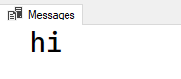
Do I need to worry about case-sensitivity?
No functions -- not even UPPER() and LOWER() -- are case-sensitive
IF UPPER('a') = 'a'
PRINT 'hi'
● LIKE is affected by collation
Notes:
If you run this today against your database, chances are you will get these results.
The reason is that your database collation is likely case-insensitive.
The UPPER function is working independently of the collation.

Slide 15
The Collation (Case-Sensitivity) Hierarchy
Instance – What was set when SQL Server was first installed?
(Builds system databases this way, sets the suggested collation for new databases)
Database – Default or explicit?
(Sets the default collation for text-based table columns)
Table Column – Provides ability to override the overarching database collation
Query-level – temporarily treat it differently in a JOIN / ORDER BY mismatch
Cannot resolve the collation conflict between "SQL_Latin1_General_CP1_CI_AS" and "Latin1_General_CI_AS" in the equal to operation.
Notes:
You may see this error in the following situations:
Cross-database joins
Linked-server queries
Server was installed with one collation, user database with another. Tempdb is using the same collation

Slide 16
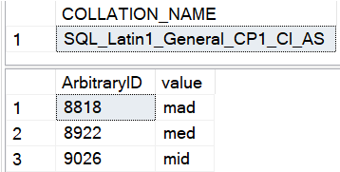
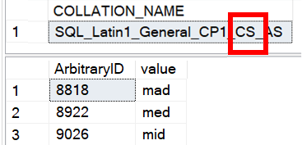
Is LIKE case-sensitive?
No functions -- not even UPPER() and LOWER() -- are case-sensitive
● LIKE is affected by the current collation
-- Request column collation
SELECT isc.COLLATION_NAME
FROM INFORMATION_SCHEMA.COLUMNS isc
WHERE isc.TABLE_NAME = 'Table_1'
AND isc.COLUMN_NAME = 'value'
-- Original query results in CAPS
SELECT t1.ArbitraryID, t1.[value]
FROM Table_1 t1
WHERE t1.[value] LIKE 'm[aei]d'
Case-insensitive DB
Case-sensitive DB
(lower-case)

Slide 17
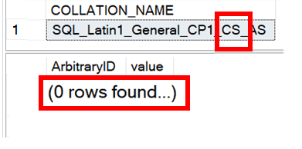
Is LIKE case-sensitive?
No functions -- not even UPPER() and LOWER() -- are case-sensitive
● LIKE is affected by the current collation
-- Request column collation
SELECT isc.COLLATION_NAME
FROM INFORMATION_SCHEMA.COLUMNS isc
WHERE isc.TABLE_NAME = 'Table_1'
AND isc.COLUMN_NAME = 'value'
-- Original query results in CAPS
SELECT t1.ArbitraryID, t1.[value]
FROM Table_1 t1
WHERE t1.[value] LIKE 'M[AEI]D'
Case-insensitive DB
Case-sensitive DB
(upper-case)

Slide 18
What if I need to worry about case-sensitivity?
Forcing case-sensitivity (to lower in example) on an case-insensitive column:
WHERE [CI_value] COLLATE Latin1_General_CS_AS LIKE 'm[aeiou]d'
Forcing case-insensitivity on a case-sensitive column:
WHERE [CS_value] COLLATE Latin1_General_CI_AS LIKE 'm[aeiou]d'
WHERE [CS_value] LIKE '[mM][aAeEiIoOuU][dD]'
WHERE LOWER([CS_value]) LIKE 'm[aeiou]d'
Notes:
If you plan to use these types of queries often, you might consider building a persisted computed column to speed up finding these results. You can index a computed column.

Slide 19
[-] – Range character
Provides a shortcut to consolidate characters on its immediate left and right
Characters must be contiguous; Lower value must be on the left.
[^] – Negation character
Provides a “NOT” to all characters on its right
Must be the FIRST character within the containment characters to take effect

Slide 20
Demo
● LIKE - Range and negation

Slide 21
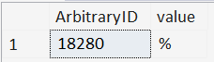
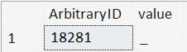
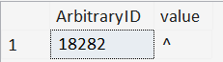
ESCAPE stringable
WHERE [value] LIKE '%\%%' ESCAPE '\'
WHERE [value] LIKE '%%' ESCAPE '%'
WHERE [value] LIKE '%!_%' ESCAPE '!'
WHERE [value] LIKE '%2^%' ESCAPE 2

Slide 22
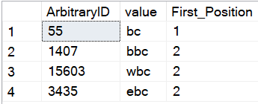
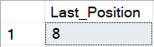
PATINDEX(LIKE_pattern, stringable)
Returns the starting position of the first occurrence of a pattern in a specified expression, or zero if the pattern is not found, on all valid text and character data types.
SELECT TOP 4 ArbitraryID
, [value]
, PATINDEX('%bc', [value]) AS [First_Position]
FROM dbo.Table_1
WHERE [value] LIKE '%bc'
ORDER BY NEWID()
--Find the "last position" using REVERSE()
DECLARE @_value varchar(20) = 'abcdefabcg'
SELECT LEN(@_value)
- PATINDEX(REVERSE('%bc%'), REVERSE(@_value))
AS [Last_Position]

Slide 23
So, like, any questions on LIKE?
Next up, REGEXP_<> functions…
● REGEXP_COUNT()
● REGEXP_LIKE()
● REGEXP_INSTR()
● REGEXP_REPLACE()
● REGEXP_SUBSTR()

Slide 24

Notes:
Regular Expressions is over 70 years old.

Slide 25










Python
JavaScript
Java
C#.NET
Perl
php
Ruby
MySQL
PostgreSQL
Azure SQL DB
Notes:
What is old is new again.

Slide 26



Should I switch to RegEx?
Do I have a compelling reason to switch to RegEx?
WHERE REGEXP_LIKE
(Email,'^[A-Za-z0-9._%+-]+@[A-Za-z0-9.-]+\.[A-Za-z]{2,}$')
WHERE Email LIKE '%@%.%'
Notes:
Is this to satisfy a problem that LIKE can’t solve?
Is the effort closing a sizable gap?
Is the strictness an important piece of data integrity?

Slide 27
Should I switch to RegEx?
Do I have time to learn this complex scripting language?
Each time I return to it?
Notes:
Unfortunately, I won’t be able to teach you everything in one hour, and your payoff may not be immediate.
Every time you come back to a Regular Expression, you will be spending time re-acclimating yourself with the syntax just to get to the logic.

Slide 28
Should I switch to RegEx?
Do I understand RegEx well enough to write in it?
Do I understand all the business rules well enough to (re-)write them in RegEx?

Slide 29



Should I switch to RegEx?
Which of my teammates can troubleshoot RegEx if I write it?
Office Space, 1999

Slide 30
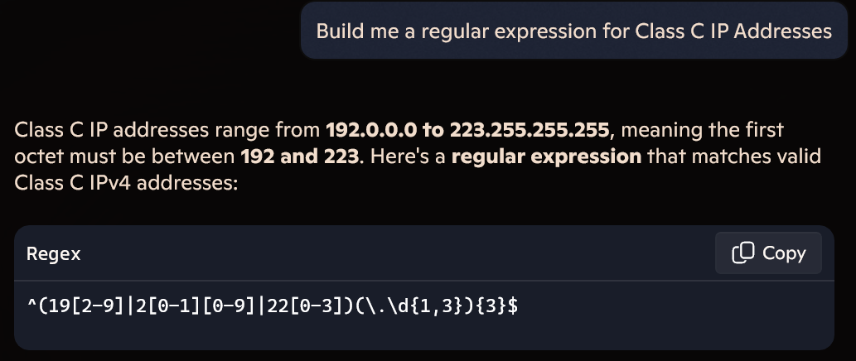
Should I switch to RegEx?
Can I steal a RegEx pattern from the Internet (search or Generative AI)?
Notes:
Generative AI can quickly give a slam-dunk Regex pattern to certain problems.

Slide 31
Should I switch to RegEx?
Can I steal a RegEx pattern from the Internet (search or Generative AI)?
Regular Expression pattern for email address:
^\S+@\S+\.\S+$
^[a-zA-Z0-9_.+-]+@[a-zA-Z0-9-]+\.[a-zA-Z0-9-.]+$
^\w+([-+.']\w+)*@\w+([-.]\w+)*\.\w+([-.]\w+)*$
Notes:
However, in other cases, not even the Internet agrees on an iron-clad solution to a pattern

Slide 32
Mail::RFC822::Address: RegExp-based address validation
(?:(?:\r\n)?[ \t])*(?:(?:(?:[^()<>@,;:\\".\[\] \000-\031]+(?:(?:(?:\r\n)?[ \t])+|\Z|(?=[\["()<>@,;:\\".\[\]]))|"(?:[^\"\r\\]|\\.|(?:(?:\r\n)?[ \t]))*"(?:(?:\r\n)?[ \t])*)(?:\.(?:(?:\r\n)?[ \t])*(?:[^()<>@,;:\\".\[\] \000-\031]+(?:(?:(?:\r\n)?[ \t])+|\Z|(?=[\["()<>@,;:\\".\[\]]))|"(?:[^\"\r\\]|\\.|(?:(?:\r\n)?[\t]))*"(?:(?:\r\n)?[ \t])*))*@(?:(?:\r\n)?[ \t])*(?:[^()<>@,;:\\".\[\] \000-\031]+(?:(?:(?:\r\n)?[ \t])+|\Z|(?=[\["()<>@,;:\\".\[\]]))|\[([^\[\]\r\\]|\\.)*\](?:(?:\r\n)?[ \t])*)(?:\.(?:(?:\r\n)?[ \t])*(?:[^()<>@,;:\\".\[\] \000-\031]+(?:(?:(?:\r\n)?[ \t])+|\Z|(?=[\["()<>@,;:\\".\[\]]))|\[([^\[\]\r\\]|\\.)*\](?:(?:\r\n)?[ \t])*))*|(?:[^()<>@,;:\\".\[\] \000-\031]+(?:(?:(?:\r\n)?[ \t])+|\Z|(?=[\["()<>@,;:\\".\[\]]))|"(?:[^\"\r\\]|\\.|(?:(?:\r\n)?[ \t]))*"(?:(?:\r\n)?[ \t])*)*\<(?:(?:\r\n)?[ \t])*(?:@(?:[^()<>@,;:\\".\[\] \000-\031]+(?:(?:(?:\r\n)?[ \t])+|\Z|(?=[\["()<>@,;:\\".\[\]]))|\[([^\[\]\r\\]|\\.)*\](?:(?:\r\n)?[ \t])*)(?:\.(?:(?:\r\n)?[ \t])*(?:[^()<>@,;:\\".\[\] \000-\031]+(?:(?:(?:\r\n)?[ \t])+|\Z|(?=[\["()<>@,;:\\".\[\]]))|\[([^\[\]\r\\]|\\.)*\](?:(?:\r\n)?[ \t])*))*(?:,@(?:(?:\r\n)?[ \t])*(?:[^()<>@,;:\\".\[\] \000-\031]+(?:(?:(?:\r\n)?[ \t])+|\Z|(?=[\["()<>@,;:\\".\[\]]))|\[([^\[\]\r\\]|\\.)*\](?:(?:\r\n)?[ \t])*)(?:\.(?:(?:\r\n)?[ \t])*(?:[^()<>@,;:\\".\[\] \000-\031]+(?:(?:(?:\r\n)?[ \t])+|\Z|(?=[\["()<>@,;:\\".\[\]]))|\[([^\[\]\r\\]|\\.)*\](?:(?:\r\n)?[ \t])*))*)*:(?:(?:\r\n)?[ \t])*)?(?:[^()<>@,;:\\".\[\] \000-\031]+(?:(?:(?:\r\n)?[ \t])+|\Z|(?=[\["()<>@,;:\\".\[\]]))|"(?:[^\"\r\\]|\\.|(?:(?:\r\n)?[ \t]))*"(?:(?:\r\n)?[ \t])*)(?:\.(?:(?:\r\n)?[ \t])*(?:[^()<>@,;:\\".\[\] \000-\031]+(?:(?:(?:\r\n)?[ \t])+|\Z|(?=[\["()<>@,;:\\".\[\]]))|"(?:[^\"\r\\]|\\.|(?:(?:\r\n)?[ \t]))*"(?:(?:\r\n)?[ \t])*))*@(?:(?:\r\n)?[ \t])*(?:[^()<>@,;:\\".\[\] \000-\031]+(?:(?:(?:\r\n)?[ \t])+|\Z|(?=[\["()<>@,;:\\".\[\]]))|\[([^\[\]\r\\]|\\.)*\](?:(?:\r\n)?[ \t])*)(?:\.(?:(?:\r\n)?[ \t])*(?:[^()<>@,;:\\".\[\] \000-\031]+(?:(?:(?:\r\n)?[ \t])+|\Z|(?=[\["()<>@,;:\\".\[\]]))|\[([^\[\]\r\\]|\\.)*\](?:(?:\r\n)?[ \t])*))*\>(?:(?:\r\n)?[ \t])*)|(?:[^()<>@,;:\\".\[\] \000-\031]+(?:(?:(?:\r\n)?[ \t])+|\Z|(?=[\["()<>@,;:\\".\[\]]))|"(?:[^\"\r\\]|\\.|(?:(?:\r\n)?[ \t]))*"(?:(?:\r\n)?[ \t])*)*:(?:(?:\r\n)?[ \t])*(?:(?:(?:[^()<>@,;:\\".\[\] \000-\031]+(?:(?:(?:\r\n)?[ \t])+|\Z|(?=[\["()<>@,;:\\".\[\]]))|"(?:[^\"\r\\]|\\.|(?:(?:\r\n)?[ \t]))*"(?:(?:\r\n)?[ \t])*)(?:\.(?:(?:\r\n)?[ \t])*(?:[^()<>@,;:\\".\[\] \000-\031]+(?:(?:(?:\r\n)?[ \t])+|\Z|(?=[\["()<>@,;:\\".\[\]]))|"(?:[^\"\r\\]|\\.|(?:(?:\r\n)?[ \t]))*"(?:(?:\r\n)?[ \t])*))*@(?:(?:\r\n)?[ \t])*(?:[^()<>@,;:\\".\[\] \000-\031]+(?:(?:(?:\r\n)?[ \t])+|\Z|(?=[\["()<>@,;:\\".\[\]]))|\[([^\[\]\r\\]|\\.)*\](?:(?:\r\n)?[ \t])*)(?:\.(?:(?:\r\n)?[ \t])*(?:[^()<>@,;:\\".\[\] \000-\031]+(?:(?:(?:\r\n)?[ \t])+|\Z|(?=[\["()<>@,;:\\".\[\]]))|\[([^\[\]\r\\]|\\.)*\](?:(?:\r\n)?[ \t])*))*|(?:[^()<>@,;:\\".\[\] \000-\031]+(?:(?:(?:\r\n)?[ \t])+|\Z|(?=[\["()<>@,;:\\".\[\]]))|"(?:[^\"\r\\]|\\.|(?:(?:\r\n)?[ \t]))*"(?:(?:\r\n)?[ \t])*)*\<(?:(?:\r\n)?[ \t])*(?:@(?:[^()<>@,;:\\".\[\] \000-\031]+(?:(?:(?:\r\n)?[ \t])+|\Z|(?=[\["()<>@,;:\\".\[\]]))|\[([^\[\]\r\\]|\\.)*\](?:(?:\r\n)?[ \t])*)(?:\.(?:(?:\r\n)?[ \t])*(?:[^()<>@,;:\\".\[\] \000-\031]+(?:(?:(?:\r\n)?[ \t])+|\Z|(?=[\["()<>@,;:\\".\[\]]))|\[([^\[\]\r\\]|\\.)*\](?:(?:\r\n)?[ \t])*))*(?:,@(?:(?:\r\n)?[ \t])*(?:[^()<>@,;:\\".\[\] \000-\031]+(?:(?:(?:\r\n)?[ \t])+|\Z|(?=[\["()<>@,;:\\".\[\]]))|\[([^\[\]\r\\]|\\.)*\](?:(?:\r\n)?[ \t])*)(?:\.(?:(?:\r\n)?[ \t])*(?:[^()<>@,;:\\".\[\] \000-\031]+(?:(?:(?:\r\n)?[ \t])+|\Z|(?=[\["()<>@,;:\\".\[\]]))|\[([^\[\]\r\\]|\\.)*\](?:(?:\r\n)?[ \t])*))*)*:(?:(?:\r\n)?[ \t])*)?(?:[^()<>@,;:\\".\[\] \000-\031]+(?:(?:(?:\r\n)?[ \t])+|\Z|(?=[\["()<>@,;:\\".\[\]]))|"(?:[^\"\r\\]|\\.|(?:(?:\r\n)?[ \t]))*"(?:(?:\r\n)?[ \t])*)(?:\.(?:(?:\r\n)?[ \t])*(?:[^()<>@,;:\\".\[\] \000-\031]+(?:(?:(?:\r\n)?[ \t])+|\Z|(?=[\["()<>@,;:\\".\[\]]))|"(?:[^\"\r\\]|\\.|(?:(?:\r\n)?[ \t]))*"(?:(?:\r\n)?[ \t])*))*@(?:(?:\r\n)?[ \t])*(?:[^()<>@,;:\\".\[\] \000-\031]+(?:(?:(?:\r\n)?[ \t])+|\Z|(?=[\["()<>@,;:\\".\[\]]))|\[([^\[\]\r\\]|\\.)*\](?:(?:\r\n)?[ \t])*)(?:\.(?:(?:\r\n)?[ \t])*(?:[^()<>@,;:\\".\[\] \000-\031]+(?:(?:(?:\r\n)?[ \t])+|\Z|(?=[\["()<>@,;:\\".\[\]]))|\[([^\[\]\r\\]|\\.)*\](?:(?:\r\n)?[ \t])*))*\>(?:(?:\r\n)?[ \t])*)(?:,\s*(?:(?:[^()<>@,;:\\".\[\] \000-\031]+(?:(?:(?:\r\n)?[ \t])+|\Z|(?=[\["()<>@,;:\\".\[\]]))|"(?:[^\"\r\\]|\\.|(?:(?:\r\n)?[ \t]))*"(?:(?:\r\n)?[ \t])*)(?:\.(?:(?:\r\n)?[ \t])*(?:[^()<>@,;:\\".\[\] \000-\031]+(?:(?:(?:\r\n)?[ \t])+|\Z|(?=[\["()<>@,;:\\".\[\]]))|"(?:[^\"\r\\]|\\.|(?:(?:\r\n)?[ \t]))*"(?:(?:\r\n)?[ \t])*))*@(?:(?:\r\n)?[ \t])*(?:[^()<>@,;:\\".\[\] \000-\031]+(?:(?:(?:\r\n)?[ \t])+|\Z|(?=[\["()<>@,;:\\".\[\]]))|\[([^\[\]\r\\]|\\.)*\](?:(?:\r\n)?[ \t])*)(?:\.(?:(?:\r\n)?[ \t])*(?:[^()<>@,;:\\".\[\] \000-\031]+(?:(?:(?:\r\n)?[ \t])+|\Z|(?=[\["()<>@,;:\\".\[\]]))|\[([^\[\]\r\\]|\\.)*\](?:(?:\r\n)?[ \t])*))*|(?:[^()<>@,;:\\".\[\] \000-\031]+(?:(?:(?:\r\n)?[ \t])+|\Z|(?=[\["()<>@,;:\\".\[\]]))|"(?:[^\"\r\\]|\\.|(?:(?:\r\n)?[ \t]))*"(?:(?:\r\n)?[ \t])*)*\<(?:(?:\r\n)?[ \t])*(?:@(?:[^()<>@,;:\\".\[\] \000-\031]+(?:(?:(?:\r\n)?[ \t])+|\Z|(?=[\["()<>@,;:\\".\[\]]))|\[([^\[\]\r\\]|\\.)*\](?:(?:\r\n)?[ \t])*)(?:\.(?:(?:\r\n)?[ \t])*(?:[^()<>@,;:\\".\[\] \000-\031]+(?:(?:(?:\r\n)?[ \t])+|\Z|(?=[\["()<>@,;:\\".\[\]]))|\[([^\[\]\r\\]|\\.)*\](?:(?:\r\n)?[ \t])*))*(?:,@(?:(?:\r\n)?[ \t])*(?:[^()<>@,;:\\".\[\] \000-\031]+(?:(?:(?:\r\n)?[ \t])+|\Z|(?=[\["()<>@,;:\\".\[\]]))|\[([^\[\]\r\\]|\\.)*\](?:(?:\r\n)?[ \t])*)(?:\.(?:(?:\r\n)?[ \t])*(?:[^()<>@,;:\\".\[\] \000-\031]+(?:(?:(?:\r\n)?[ \t])+|\Z|(?=[\["()<>@,;:\\".\[\]]))|\[([^\[\]\r\\]|\\.)*\](?:(?:\r\n)?[ \t])*))*)*:(?:(?:\r\n)?[ \t])*)?(?:[^()<>@,;:\\".\[\] \000-\031]+(?:(?:(?:\r\n)?[ \t])+|\Z|(?=[\["()<>@,;:\\".\[\]]))|"(?:[^\"\r\\]|\\.|(?:(?:\r\n)?[ \t]))*"(?:(?:\r\n)?[ \t])*)(?:\.(?:(?:\r\n)?[ \t])*(?:[^()<>@,;:\\".\[\] \000-\031]+(?:(?:(?:\r\n)?[ \t])+|\Z|(?=[\["()<>@,;:\\".\[\]]))|"(?:[^\"\r\\]|\\.|(?:(?:\r\n)?[ \t]))*"(?:(?:\r\n)?[ \t])*))*@(?:(?:\r\n)?[ \t])*(?:[^()<>@,;:\\".\[\] \000-\031]+(?:(?:(?:\r\n)?[ \t])+|\Z|(?=[\["()<>@,;:\\".\[\]]))|\[([^\[\]\r\\]|\\.)*\](?:(?:\r\n)?[ \t])*)(?:\.(?:(?:\r\n)?[ \t])*(?:[^()<>@,;:\\".\[\] \000-\031]+(?:(?:(?:\r\n)?[ \t])+|\Z|(?=[\["()<>@,;:\\".\[\]]))|\[([^\[\]\r\\]|\\.)*\](?:(?:\r\n)?[ \t])*))*\>(?:(?:\r\n)?[ \t])*))*)?;\s*)
6342 characters
https://pdw.ex-parrot.com/Mail-RFC822-Address.html
Notes:
Or the pattern is so ridiculous that it’s not maintainable. This is the Internet Engineering Task Force (IETF) standard for email addresses.

Slide 33
Should I switch to RegEx?
Can I steal a RegEx pattern from the Internet (search or Generative AI)?
(Does the Internet agree on a pattern?)

Slide 34
Additional points?

Slide 35

Key Differences between LIKE and REGEXP_<>
A default LIKE search matches the sensitivity of the database collation
(We discussed this earlier)
A default REGEXP_<> search is case-sensitive,
irrespective of database collation

Slide 36
Key Differences between LIKE and REGEXP_<>
The pattern provided to LIKE implies beginning, middle, end, and length based on the characters given to it
mad
med
mid
mod
mud
WHERE [value] LIKE 'm[aeiou]d'
Implied start Implied end

Slide 37

Key Differences between LIKE and REGEXP_<>
The pattern provided to REGEXP_<> is allowed to appear anywhere in the string to match. Additional directives are applied to specify beginning and end of string.
1. WHERE REGEXP_LIKE([value], 'm[aeiou]d')
2. WHERE REGEXP_LIKE([value], '^m[aeiou]d')
3. WHERE REGEXP_LIKE([value], 'm[aeiou]d$')
+
(Start-of-text character)
(End-of-text character)

Slide 38
Key Differences between LIKE and REGEXP_<>
The pattern provided to REGEXP_<> is allowed to appear anywhere in the string to match. Additional directives are applied to specify beginning and end of string.
Clause 1 | Clause 2 | Clause 3
m[aeiou]d | ^m[aeiou]d | m[aeiou]d$
mad | mad | mad
maddening | maddening | maddening
med | med | med
mid | mid | mid
mod | mod | mod
mud | mud | mud
nomad | nomad | nomad
1. WHERE REGEXP_LIKE([value], 'm[aeiou]d')
2. WHERE REGEXP_LIKE([value], '^m[aeiou]d')
3. WHERE REGEXP_LIKE([value], 'm[aeiou]d$')

Slide 39
The similarities…
Pattern | LIKE | REGEXP
Any one character from a selection | [abc] | [abc]
Any character not in the selection | [^abc] | [^abc]
Any one character in the range | [a-g] | [a-g]
Any numeric in the range | [1-4] | [1-4]

Slide 40
Some transcribed syntax for characters…
Pattern | LIKE | REGEXP
Exactly 1 character (ignoring \n) | _ | .
 |  | .{1}
Any 0+ characters (ignoring \n) | % | .*
 |  | .{0,}
Any 1+ characters (ignoring \n) | _% | .+
 |  | .{1,}
Escaping a symbol | '!_' ESCAPE '!' | \.
“Quantifiers”

Slide 41
Some transcribed syntax for numerics…
Pattern | LIKE | REGEXP
Exactly 1 numeric | [0-9] | [0-9]
 |  | [0-9]{1}
 |  | \d{1}
Any 0+ numerics | n/a | [0-9]*
 |  | [0-9]{0,}
 |  | \d*
 |  | \d{0,}
Any 1+ numerics | n/a | [0-9]+
 |  | [0-9]{1,}
 |  | \d+
 |  | \d{1,}
“Metacharacters”

Slide 42
Too complex for LIKE…
Pattern | LIKE | REGEXP
Exactly n numeric characters |  | [0-9]{n}
At least n numeric characters |  | [0-9]{n,}
Between n and m numeric characters |  | [0-9]{n,m}
Any one phrase from a selection |  | (oh|on)
Any one phrase, repeated n times |  | (oh|on){n}
Either zero or one lowercase letter |  | [a-z]?

Slide 43
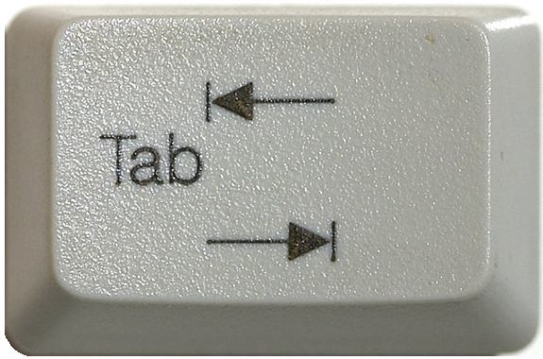

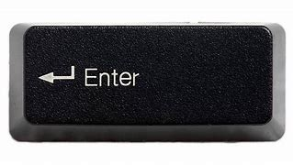
The metacharacters… easier or harder?
([0-9]|[a-zA-Z]|[!@$%&]|[ ]) → .
([0-9]|[a-zA-Z]|[!@$%&]|[ ]) → \d
([0-9]|[a-zA-Z]|[!@$%&]|[ ]) → \D
([0-9]|[a-zA-Z]|[!@$%&]|[ ]) → \w
([0-9]|[a-zA-Z]|[!@$%&]|[ ]) → \W
([0-9]|[a-zA-Z]|[!@$%&]|[ ]) → \s
([0-9]|[a-zA-Z]|[!@$%&]|[ ]) → \S
Newline goes in
this lane, right?
Depends. 🤷❓
Stay tuned for “flags”
Notes:
The period denotes a single character, including the period. Whether or not it includes the newline character depends on “flags,” which will be discussed later.
The “\d” metacharacter stands for the “digit” characters. Capitalizing to “\D” gives the inverse of this list: everything that is not a digit.
The “\w” metacharacter stands for “word” characters. Capitalizing to “\W” includes anything not found in a word
The “\s” metacharacter stands for “whitespace” characters. Capitalizing to “\S” includes anything not considered whitespace.

Slide 44
Basic REGEXP_<> syntax
char,
nchar,
varchar (MAX),
nvarchar (MAX)
<REGEXP_FUNC>(string_or_stringColumn
, RegExPtrn
)
Notes:
All RegExp functions apply to some string and will at least require a Regular Expression pattern.

Slide 45
Basic REGEXP_<> syntax
<REGEXP_FUNC>(string_or_stringColumn
, RegExPtrn
, Param1
, Param2
, flags
, Param4
)
Notes:
All of them will also have one or more additional parameters, but they will have default values

Slide 46
Basic REGEXP_<> syntax
<REGEXP_FUNC>(string_or_stringColumn
, RegExPtrn
[, Param1 = 'default']
[, Param2 = 'default']
[, flags = 'default']
[, Param4 = 'default']
)
Notes:
The way SQL Server designed the function though, is the parameter ordering is very specific, since most of the values are numbers

Slide 47
Basic REGEXP_<> syntax
<REGEXP_FUNC>(string_or_stringColumn
, RegExPtrn
[, Param1 = 'default'
[, Param2 = 'default'
[, flags = 'default'
[, Param4 = 'default'
]
]
]
)
Notes:
You do not have to provide values to any optional default parameters

Slide 48
Basic REGEXP_<> syntax
<REGEXP_FUNC>(string_or_stringColumn
, RegExPtrn
[, Param1 = 'default'
[, Param2 = 'default'
[, flags = 'default'
[, Param4 = 'default'
]
]
]
)
Notes:
But if I want to edit this parameter to a non-default value…

Slide 49
Basic REGEXP_<> syntax
<REGEXP_FUNC>(string_or_stringColumn
, RegExPtrn
, Param1 = 'default'
, Param2 = 'value'
[, flags = 'default'
[, Param4 = 'default'
]
)
Notes:
I have to explicitly request all preceding parameters and values before it, even if I repeat the default value

Slide 50
<REGEXP_FUNC>(stringable, RegExPtrn...[,flags='c'])
Flag | Mode | Description
i | Ignore case | Performs case-insensitive matching.
c | Default | Performs case-sensitive matching. (default)
s | “Dot-all” | Allows the period (.), to match the newline character (\n)
m | Multi-line | ^ and $ match “begin/end line” in addition to “begin/end text”
Notes:
Oracle uses very similarly-named functions. The s-flag is replaced by the n-character in Oracle.

Slide 51
Build some example data
CREATE TABLE dbo.Employees (
ID INT IDENTITY(101,1),
[Name] VARCHAR(150),
Email VARCHAR(320),
Phone_Number VARCHAR(20)
);
INSERT INTO dbo.Employees ([Name], Email, Phone_Number)
VALUES ('John Doe', 'john@contoso.com', '123-456-7890')
, ('Alice Smith', 'alice@fabrikam.com', '234-567-8901')
, ('Bob Johnson', 'bob@fabrikam.net','345-678-9012')
, ('Eve Jones', 'eve@contoso.com', '456-789-0123')
, ('Charlie Brown', 'charlie@contoso.co.in', '567-890-124');
Bad data
https://devblogs.microsoft.com/azure-sql/introducing-regular-expression-regex-support-in-azure-sql-db/

Slide 52
REGEXP_COUNT ( string, RegExPtrn [,startPos = 1 [,flags = 'c']] )
Returns the number of times a regular-expression pattern matches within a string
REGEXP_LIKE(string, RegExPtrn [,flags='c'])
Determines if a string matches a regular expression.
REGEXP_INSTR (string, RegExPtrn [,startPos = 1 [,occurrence = 1
[,return_option = 0 [,flags = 'c']]]] )
From the starting position of some string, find the nᵗʰ occurrence of a Regex pattern, and return its starting/ending position (based on return_option).

Slide 53
Demo
● REGEXP_COUNT
● REGEXP_LIKE
● REGEXP_INSTR

Slide 54
Sub-expressions
SELECT ID, Phone_Number
FROM dbo.Employees
WHERE REGEXP_LIKE(Phone_Number
, '^\d{3}-\d{3}-(9012|0123)$' )
(9012|0123)
Notes:
Earlier while talking about REGEXP_LIKE, we saw the use of parenthesis.
We used them to “wall-off” a list of acceptable values within a certain portion of the pattern.
The pattern contained within parenthesis is called a sub-expression.

Slide 55
Sub-expressions
SELECT ID, Phone_Number
FROM dbo.Employees
WHERE REGEXP_LIKE(Phone_Number
, '^(\d{3})-(\d{3})-(9012|0123)$' )
\1 \2 \3
Notes:
And we can wall-off anything inside a regular expression, even it leaves one option within.

Slide 56
REGEXP_REPLACE ( string, RegExPtrn, withPattern [, startPos = 1 [, occurrence = 0 [, flags = 'c']]] )
Functions supporting sub-expressions
Returns an in-string replacement of one regular expression pattern, with another regular expression pattern.
REGEXP_SUBSTR (string, RegExPtrn [,startPos = 1 [,occurrence = 1
[,flags = 'c' [,whichSubExp = 0]]]] )
Extracts a substring -- matching a regular expression pattern -- found within a string
Notes:
Using REGEXP_REPLACE, we can redecorate data using sub-expressions.
Sub-expressions are numbered based on their creation from left-to-right
SQL Server only supported numbered expressions at this time.
If the data does not meet the criteria of the regular expression, it is returned with no modifications.

Slide 57
Demo
● REGEXP_REPLACE
● REGEXP_SUBSTR

Slide 58
Flags revisited…
Flag | Mode | Description
i | Ignore case | Performs case-insensitive matching.
c | Default | Performs case-sensitive matching. (default)
s | “Dot-all” | Allows the period (.), to match the newline character (\n)
m | Multi-line | ^ and $ match “begin/end line” in addition to “begin/end text”
Notes:
Oracle uses very similarly-named functions. The s-flag is replaced by the n-character in Oracle.

Slide 59
Flags revisited…
Mixed-casing within multi-line
SELECT REGEXP_COUNT('this is a line
This is another line
Third line', '^Thi' [,...]) AS [Count]
Multi-line
Line starts with “Thi”
Flags go here…

Slide 60
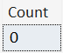
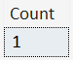
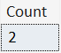
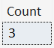
Flags revisited…
SELECT REGEXP_COUNT('this is a line
This is another line
Third line', '^Thi', 1, 'sc') AS [Count]
SELECT REGEXP_COUNT('this is a line
This is another line
Third line', '^Thi', 1, 'si') AS [Count]
SELECT REGEXP_COUNT('this is a line
This is another line
Third line', '^Thi', 1, 'mc') AS [Count]
SELECT REGEXP_COUNT('this is a line
This is another line
Third line', '^Thi', 1, 'mi') AS [Count]

Slide 61
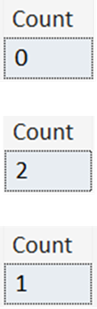
Flags revisited…
SELECT REGEXP_COUNT('Hello World
hello universe
HELLO AGAIN!
hello multi-line match!'
, '^hello.*$', 1, 'sc') AS [Count]
SELECT REGEXP_COUNT('Hello World
hello universe
HELLO AGAIN!
hello multi-line match!'
, '^hello.*$', 1, 'mc') AS [Count]
SELECT REGEXP_COUNT('Hello World
hello universe
HELLO AGAIN!
hello multi-line match!'
, '^hello.*$', 1, 'msc') AS [Count]
Notes:
The m and s flags are not mutually exclusive: they can be combined.

Slide 62
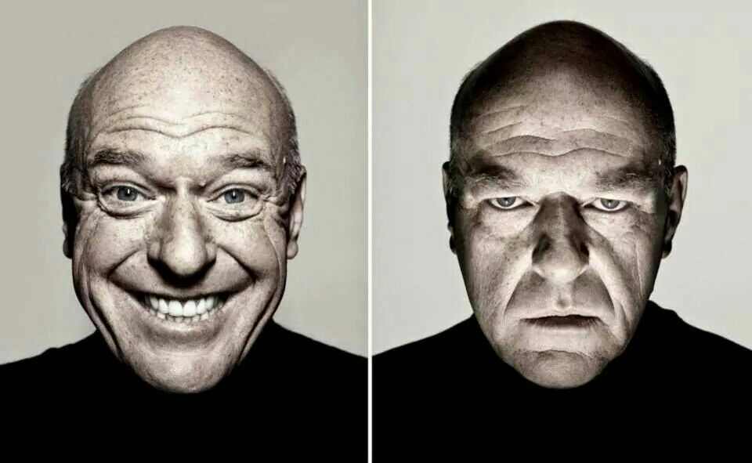
Closing Thoughts…
Developer
DBA

Slide 63
Demo
https://regex101.com/
Four score and seven years ago our fathers brought forth, upon this continent, a new nation, conceived in liberty, and dedicated to the proposition that all men are created equal.
Now we are engaged in a great civil war, testing whether that nation, or any nation so conceived, and so dedicated, can long endure. We are met on a great battle field of that war. We come to dedicate a portion of it, as a final resting place for those who died here, that the nation might live. This we may, in all propriety do.

Slide 64
Performance
SELECT [Name], Email, REGEXP_INSTR(email, '@') AS [Position_of_@]
FROM Employees
WHERE REGEXP_INSTR(email, '@') > 0
SELECT [Name], Email, CHARINDEX('@', email ) AS [Position_of_@]
FROM Employees
WHERE Email LIKE '%@%'

Slide 65
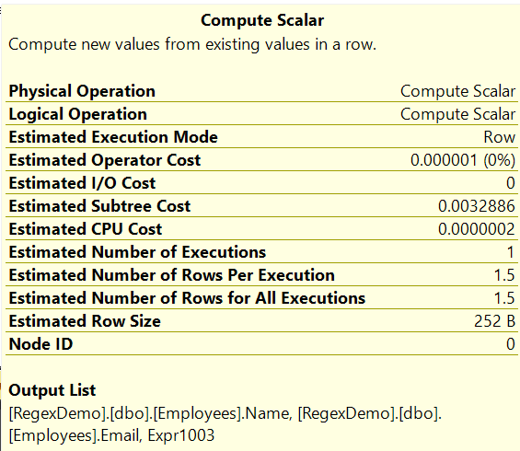
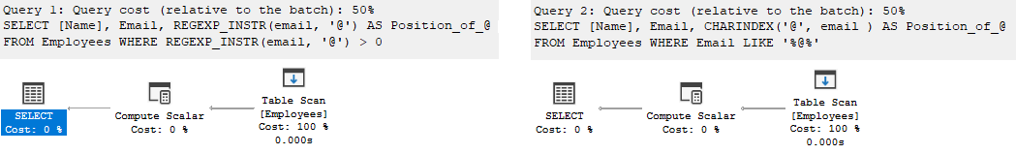
Performance
SELECT [Name], Email, REGEXP_INSTR(email, '@') AS [Position_of_@]
FROM Employees
WHERE REGEXP_INSTR(email, '@') > 0
SELECT [Name], Email, CHARINDEX('@', email ) AS [Position_of_@]
FROM Employees
WHERE Email LIKE '%@%'
Query 1 (relative to the batch): 50% Query 2 (relative to the batch): 50%

Slide 66
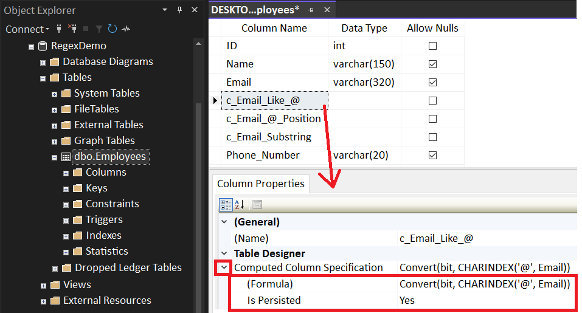
Computed Column
ALTER TABLE dbo.Employees
ADD c_Email_Like_@ AS Convert(bit, CHARINDEX('@', Email)) PERSISTED
, c_Email_@_Position AS CHARINDEX('@', Email) PERSISTED
, c_Email_Substring AS SUBSTRING(Email, 8, 1) PERSISTED

Slide 67
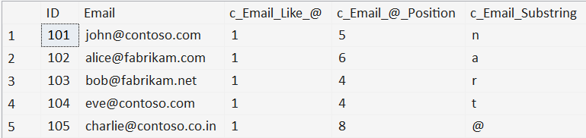
Computed Column
ALTER TABLE dbo.Employees
ADD c_Email_Like_@ AS CONVERT(bit, CHARINDEX('@', Email)) PERSISTED
, c_Email_@_Position AS CHARINDEX('@', Email) PERSISTED
, c_Email_Substring AS SUBSTRING(Email, 8, 1) PERSISTED
SELECT [ID]
, [Email]
, [c_Email_Like_@]
, [c_Email_@_Position]
, [c_Email_Substring]
FROM [dbo].[Employees]
WHERE [c_Email_Like_@] = 1
OR [c_Email_@_Position] > 0
OR [c_Email_Substring] = '@'

Slide 68
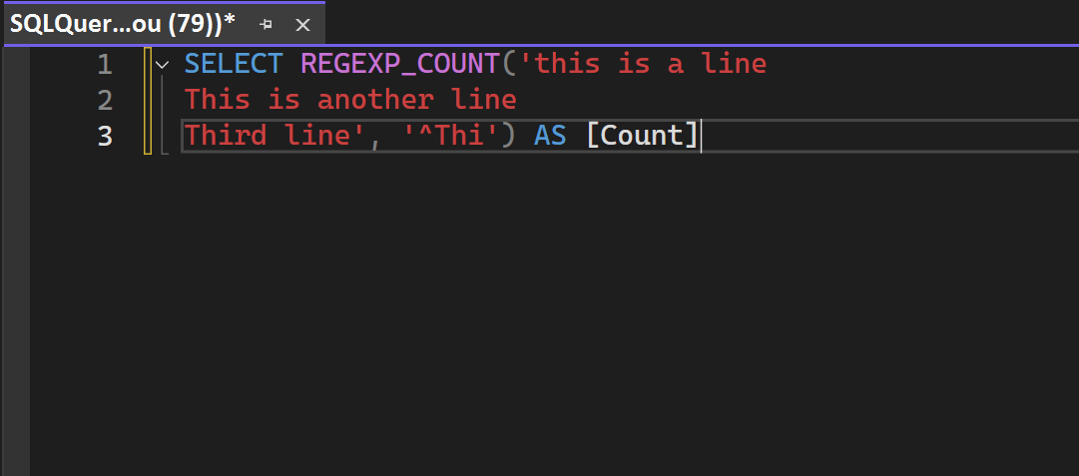
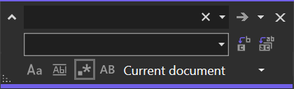
SSMS Find/Replace

Slide 69
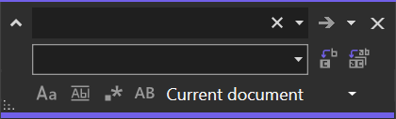
SSMS Find/Replace
(Find box)
(Replace box)
●
●
●
Match Case: Denotes if a case-sensitive search is performed for the subject
Match Whole Word: Denotes if additional alphabetic characters leading or
trailing the subject voids the result
Preserve Case: On replacement, maintain the original casement of the subject
(lowercase, UPPERCASE, Proper Case)

Slide 70
SSMS Find/Replace
(Find box)
(Replace box)
●
Regex Mode: Interprets the Find/Replace boxes as Regular Expression directives

Slide 71
Demo (if time allows)
SSMS – Find/Replace in Regex Mode

Slide 72



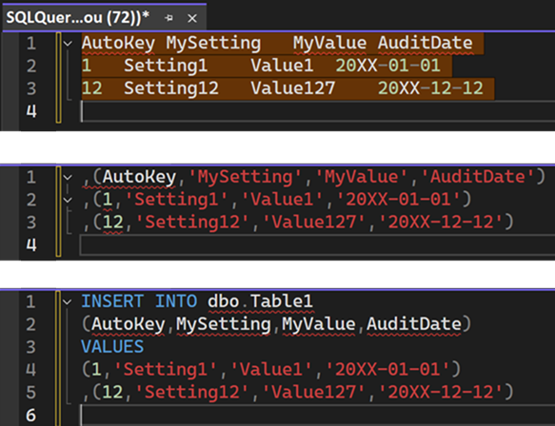
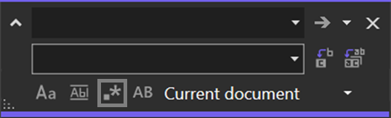
SSMS Find/Replace
^(.*)\t(.*)\t(.*)\t([^\r]*)$
,($1,'$2','$3','$4')
(Minor manual clean-up)
Notes:
$ only matches \n (newline), not \r (carriage return).
Thanks to Erin Stellato at Microsoft for help with this.

Slide 73
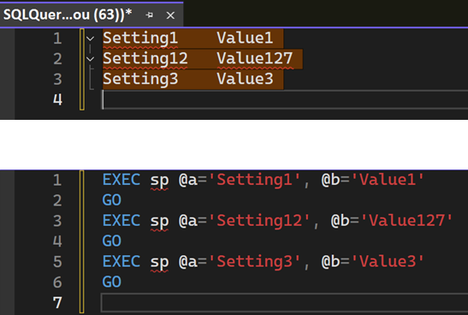
SSMS Find/Replace
^(.*)\t([^\r]*)$
EXEC sp @a='$1', @b='$2'\nGO
Notes:
$ only matches \n (newline), not \r (carriage return).
Thanks to Erin Stellato at Microsoft for help with this.

Slide 74
Where do we go from here?
Learned more than just % for LIKE
Scratched the surface on Regular Expression syntax
Introduced to the REGEXP functions
● REGEXP_COUNT()
● REGEXP_LIKE()
● REGEXP_INSTR()
● REGEXP_REPLACE()
● REGEXP_SUBSTR()
Experienced the Regex mode of SSMS Find/Replace

Slide 75
Jeff Foushee
SQL Server Database Admin
Programmer
SQL Saturday speaker
Blackjack dealer
https://www.linkedin.com/in/jeff-foushee/
https://github.com/jbfoushee/MyPresentations/

Slide 76

Advanced T-SQL Pattern Matching: Leveraging LIKE and Regular Expressions
https://github.com/jbfoushee/MyPresentations/

